Slide 1
Web Lab Mini-Project Presentation
Title:“E-Commerce Website”
Presented By
Sanjay Paudel USN: 1BY17IS068
Sushan Prajapati USN: 1BY17IS069
Suyes Sapkota USN: 1BY17IS070
Under the guidance of
Asst. Prof. Bhavya G
2020-21

Slide 2
Abstract:
Everything in the world has become digital in this era.
E-commerce is fast gaining ground as an accepted and used business paradigm.
It is reasonable to say that the process of shopping on the web is becoming commonplace.
More and more business houses are implementing web sites providing functionality for performing commercial transactions over the web.

Slide 3
Introduction:
Electronic commerce or e-commerce is a term for any type of business, or commercial transaction, that involves the transfer of information across the Internet.
It is currently one of the most important aspects of the Internet to emerge.
An e-commerce website is an information technology method in which traders, businesses/distributors/marketers can sell products/services and the customer can purchase on that website electronically by using the internet on the mobile and computer.

Slide 4
Existing System:
This existing system of buying goods has several disadvantages.
It requires lots of time to travel to the particular shop to buy the goods.
Since everyone is leading busy life now a days, time means a lot to everyone. Also, there are expenses for travelling from house to shop.
More over the shop from where we would like to buy something may not be open 24*7*365.

Slide 5
Objectives:
Getting brief idea of using different tools like PHP, HTML into real world problems.
Easy scanning and selecting items in a list.
Effective categorical organization of products.
Simple navigation from home page to information and order links for specific products.
Returning to different parts of the site after adding an item to the shopping cart.

Slide 6
Proposed System:
In order to overcome the defects of traditional commerce, we have e-commerce solution where we can get all required goods online.
The proposed system helps in building a website to buy, sell products or goods online using internet connection.
Purchasing online, user can choose different products based on categories, online payments/cash on delivery, delivery services and hence covering the disadvantages of the existing system and helping the vendors to reach wider market.

Slide 7
Proposed System:
We will be using HTML, CSS and JavaScript to create a nice interface for users so that they will feel comfortable and handy while browsing the different products.
Flexible site with flexible admin panel to monitor all the products, reviews and orders will be the main idea of this project.

Slide 8
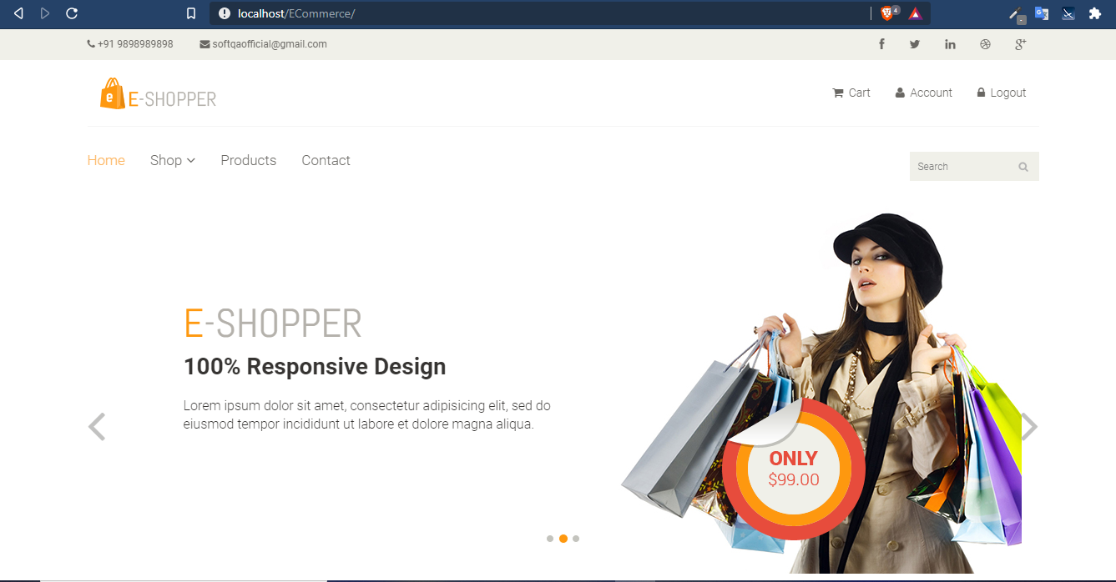
Interpretation of Results:
Fig.: Main Interface

Slide 9
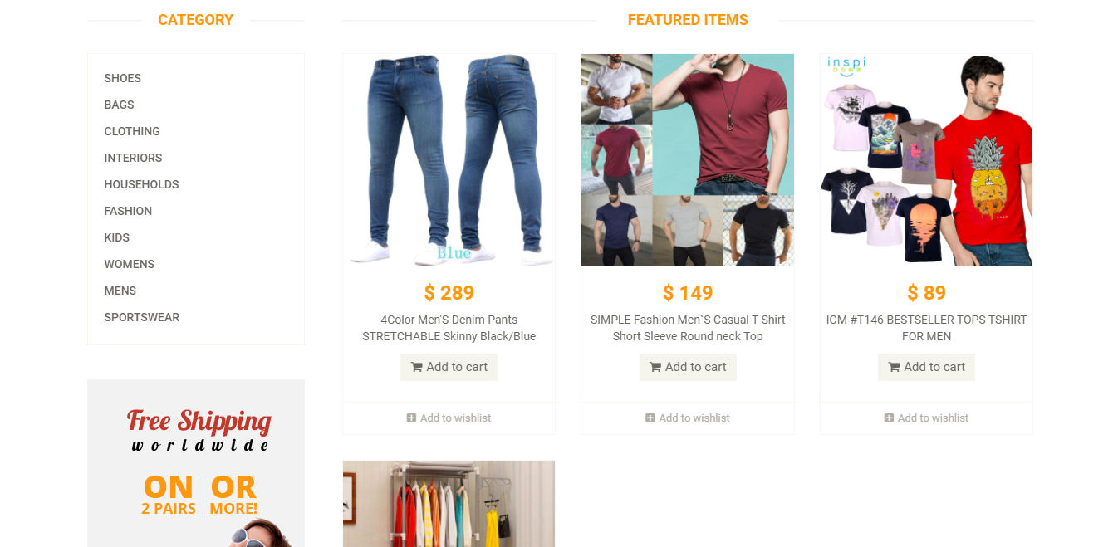
Fig.:Products

Slide 10
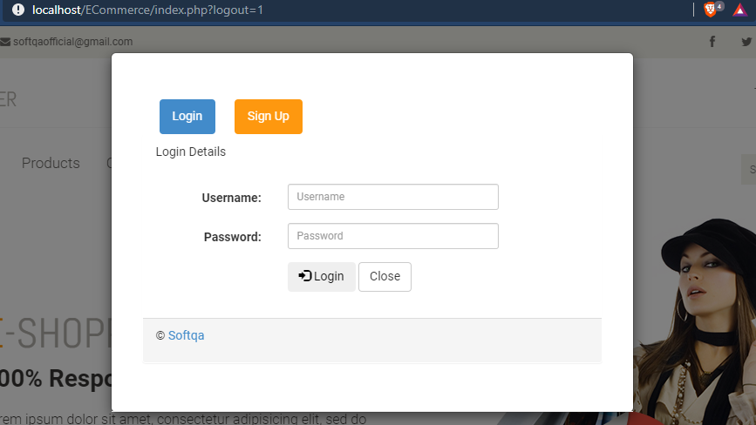
Fig.:Login Page

Slide 11
System Requirement Specifications:
Hardware Specification: Desktop/Laptop with min.512MB RAM, minimum 10GB of Hard disk.
Software Specification: Any editing platforms (Brackets, Visual Studio, Sublime), XAMP
Language Specifications:
Front-End: HTML, JavaScript, CSS
Back-End: MySQL, PHP

Slide 12
References : (IEEE format)
[1] Vijaya Sharma, “eCommerce Website Introduction with easy examples”,
klientsolutech.com, December 22,2018. [Online]. Available: https://www.klientsolutech.com/ecommerce-website-introduction-with-examples/ . [Accessed Oct. 20,2020].
[2] geetanarang6268, “What is traditional commerce advantages and disadvantages?”,
https://brainly.in, June 10, 2018. [Online]. Available: https://brainly.in/question/6047740 .[Accessed Oct. 20,2020].
[3] Kavya Nair, “10 Advantages of E-commerce Over Traditional Commerce”, yo-kart.com,Oct 05, 2017. [Online]. Available: https://www.yo-kart.com/blog/10-advantages-of-e-commerce-over-traditional-commerce . [Accessed Oct. 20,2020].
[4] CREATIVEWORLD9, “Abstract on E-COMMERCE”, creativeworld9.com, para 2, 2010.[Online]. Available: http://www.creativeworld9.com/2011/03/abstract-on-e-commerce.html.[Accessed Oct. 21,2020].

Slide 13
Thank you

